Slide 1
Spring REST - Global Exception Handling

Slide 2
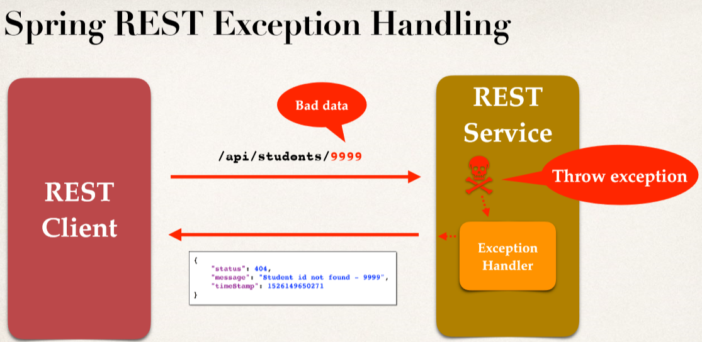

Slide 3
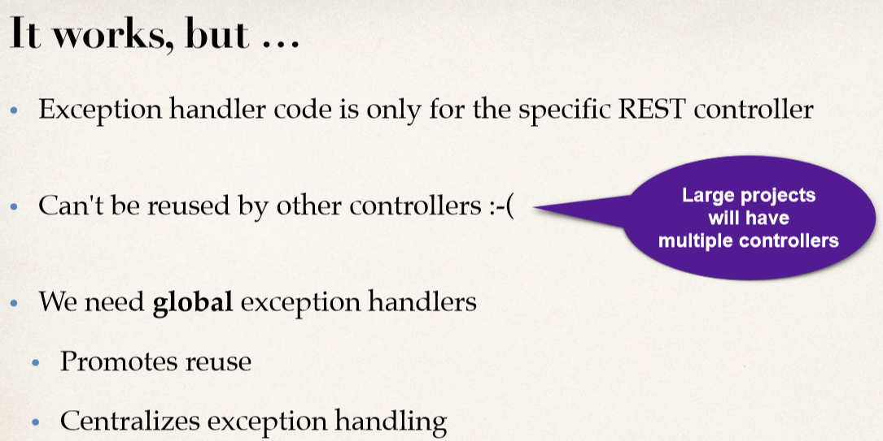

Slide 4
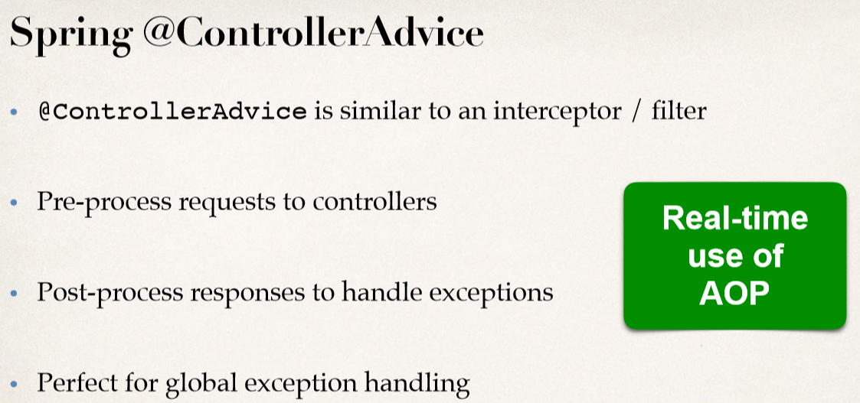

Slide 5
